Slide 1

Capstone Project : TEAM CORE FOUR
Development of an asynchronous framework for implementing API endpoints for accessing data in Sun Crest's Oracle database schema.
SPONSOR: John Chookolingo
jchookolingo@suncrestinc.com
MENTOR: Shahdad Shariatmadari
PREPARED BY:
Raj Chauhan (N01494277) Vidhi Patel (N01426021) Jinal Patel (N01495566) Mirul Patel (N01489347)

Slide 2
TABLE OF CONTENTS
Introduction
Oracle Table Structure & Stored Procedure
Fast API
JSON Data Insertion Operation
Pytest: Testing environment
Security Measures
Conclusion

Slide 3
INTRODUCTION
WHAT?
To modernize Sun Crest's software architecture, a well-designed API layer can facilitate information sharing between the core system and external systems.
By using the Fast API framework, a high-performance, easy-to-use, and lightweight web framework for building APIs with Python, Sun Crest can build a robust and scalable API layer.
Sun Crest has a two-tier Oracle based Software Solution, which they wish to modernize via adding an API layer that will add significant capabilities to use modern front end such as Web Browsers and Spreadsheets Program (like Excel, Google Sheets) to interact with the database via JSON.
After conducting research and learning about Fast API, we informed Sun Crest that Fast API would probably be the successful solution to the problem
Upon approval, we created the Fast API from the scratch and demonstrated that it worked in Async mode
The team has designed various endpoints according to the company’s requirements.
WHY?
HOW?

Slide 4
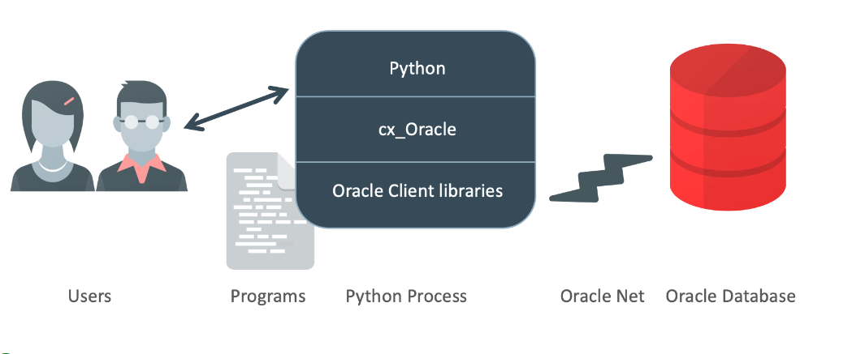
INTRODUCTION

Slide 5





MEET OUR TEAM
Raj Chauhan
Vidhi Patel
Mirul Patel
Jinal Patel
Leader
Member
Member
Member

Slide 6
PROJECT SCOPE FLOW
Installed and setup Oracle Developer. Learned, researched and connected the sample database with FastAPI.
Researched and successful integrated FastAPI async mode, Setup the Dev Environment, oracle database connected, and data fetched through FastAPI
Created Stored Procedure in oracle database and successfully applied the same in FastAPI. We have also developed Fast API which fetch the data from database through GET Method.
We have executed GET METHOD for insertion (for simplicity of testing from a web browser) where we called procedure which was previously designed in Oracle Database.
Executed the insertion using the POST METHOD through POSTMAN application

Slide 7
PROJECT SCOPE FLOW
Enhance and test to service asynchronous calls from multiple clients at the same time and ensure that asynchronous calls are not blocked
Designed CRUD (REST API) routes
Researched and executed JSON functionality build into the Oracle by creating test and complex queries
Tested All endpoints in Pytest: Testing environment.
Hosted all endpoints on IP address instead of localhost which was production-ready environment and Researched security measures with Fast API

Slide 8
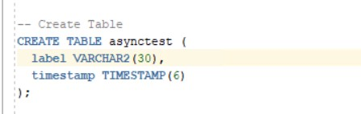
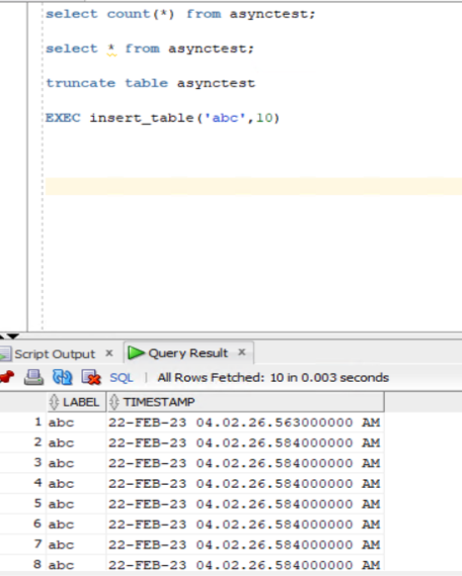
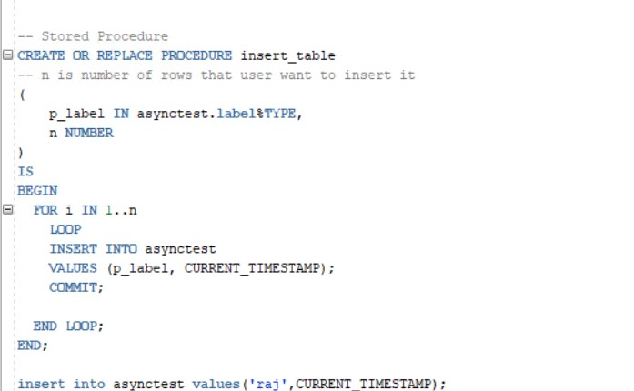
TABLE STRUCTURE & STORED PROCEDURE
Created Stored Procedure named “insert_table” where we used the loop to insert the label and current timestamp of the particular row being inserted

Slide 9
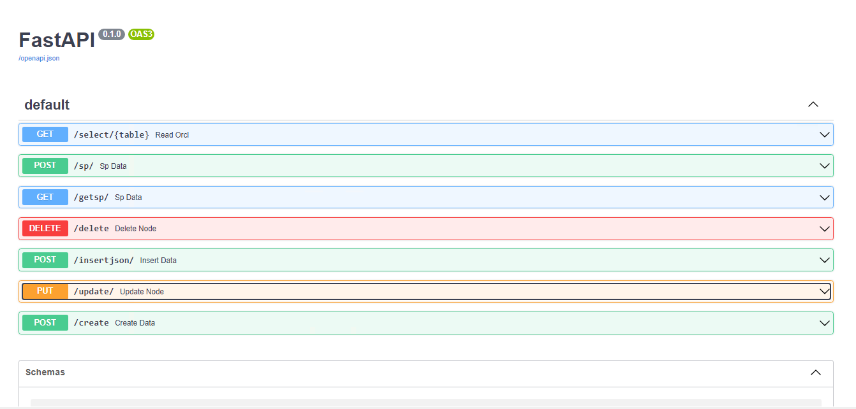
Fast API
Fast API is a modern, fast, web framework for building APIs with Python 3.7+ based on standard Python type hints. It is designed to be fast, easy to use, and highly performant.
We use Fast API as it is known for its speed and asynchronous capabilities, which allows it to handle a large volume of requests and provide real-time responses. Additionally, it supports features like automatic data validation, automatic API documentation, and an intuitive user interface, which make it a powerful tool for building efficient and scalable APIs.
One of the key advantages of FastAPI is its ability to handle asynchronous requests, which can greatly improve the performance and scalability of an API. It also provides out-of-the-box support for a range of data formats, including JSON and CSV.

Slide 10
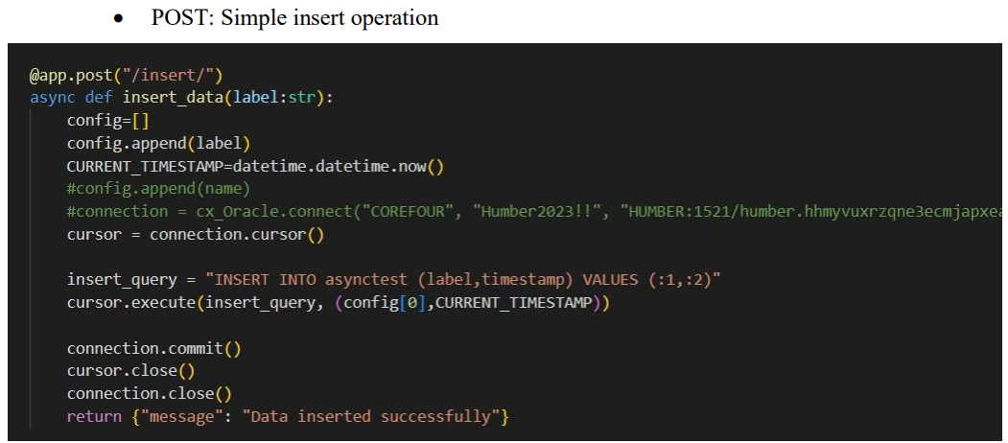
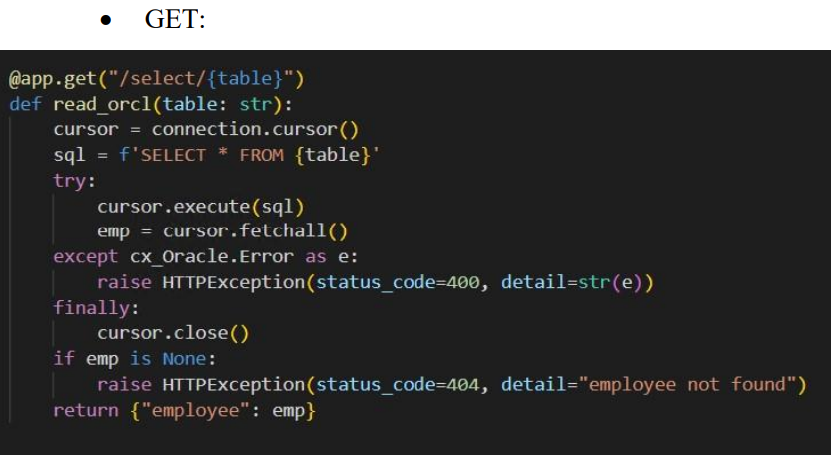
CRUD: FAST API
Create: This operation is used to create a new record in the database. In FastAPI, we defined an endpoint for creating a new record using the POST HTTP method.
Read: This operation is used to retrieve records from the database. In FastAPI, we defined an endpoint for retrieving records using the GET HTTP method.

Slide 11
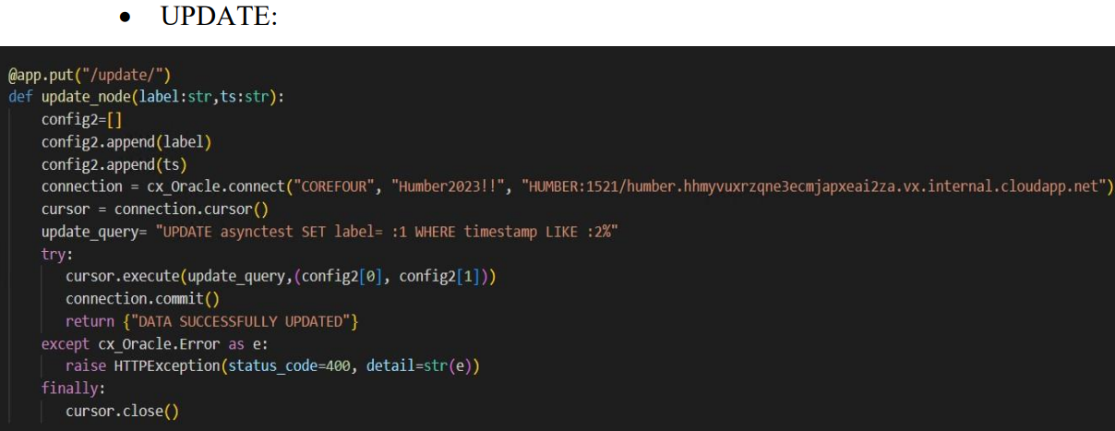
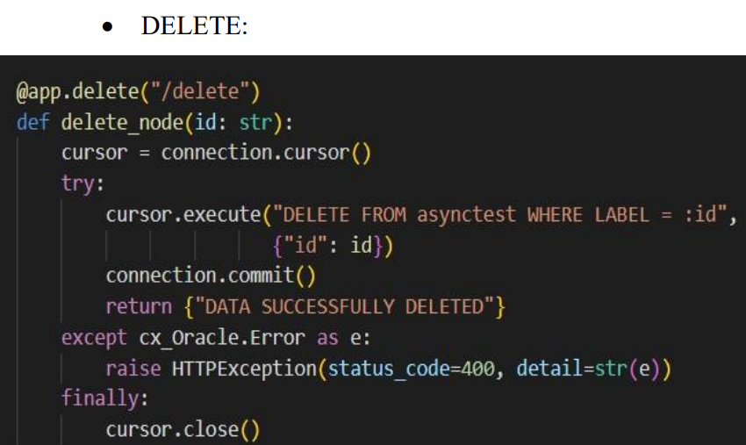
FAST API: CRUD
Update: This operation is used to update an existing record in the database. In FastAPI, we defined an endpoint for updating a record using the PUT HTTP method.
Delete: This operation is used to delete an existing record from the database. In FastAPI, we defined an endpoint for deleting a record using the DELETE HTTP method.

Slide 12
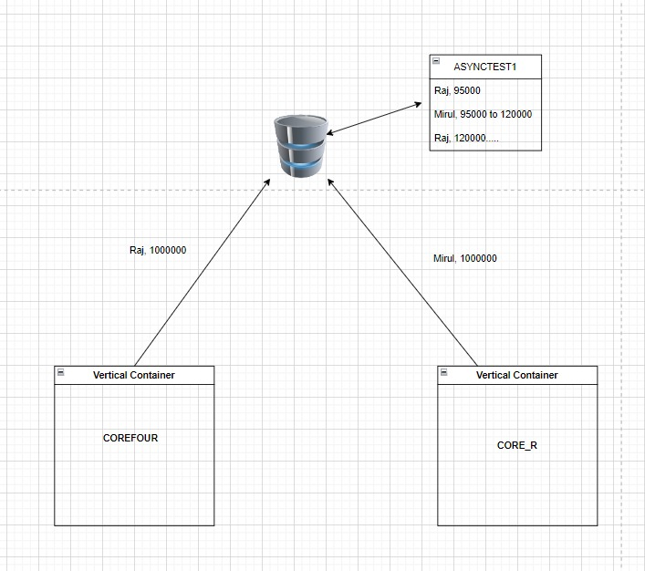
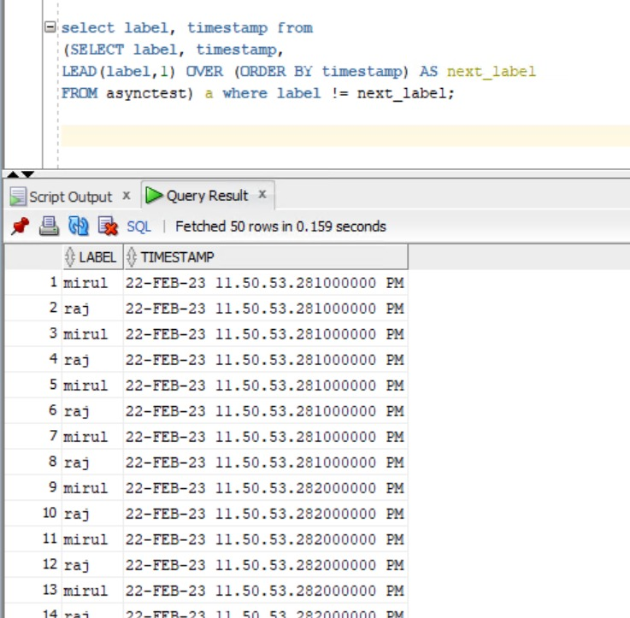
FAST API : ASYNCHRONOUS TESTING
There was a major requirement from Sun Crest for the team to prove that the FastAPI would not block the asynchronous calls at the Oracle library level

Slide 13
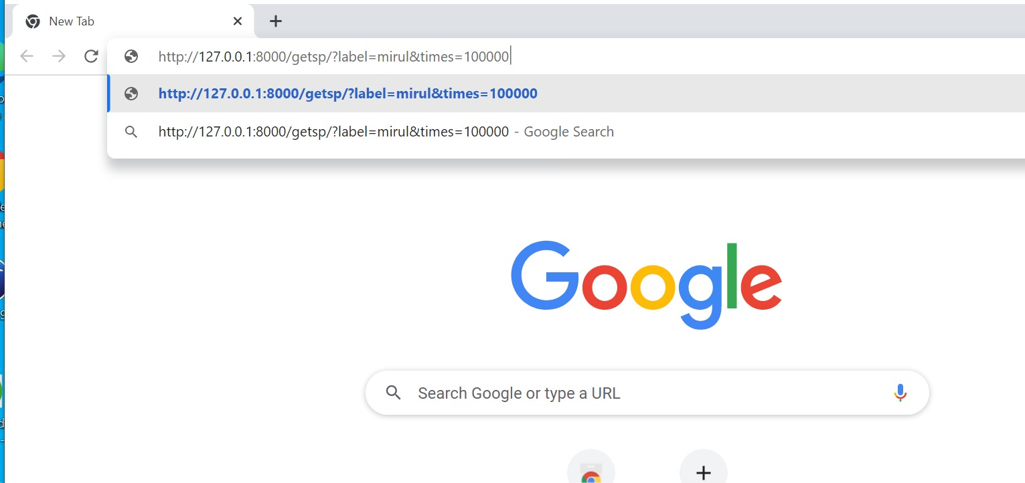
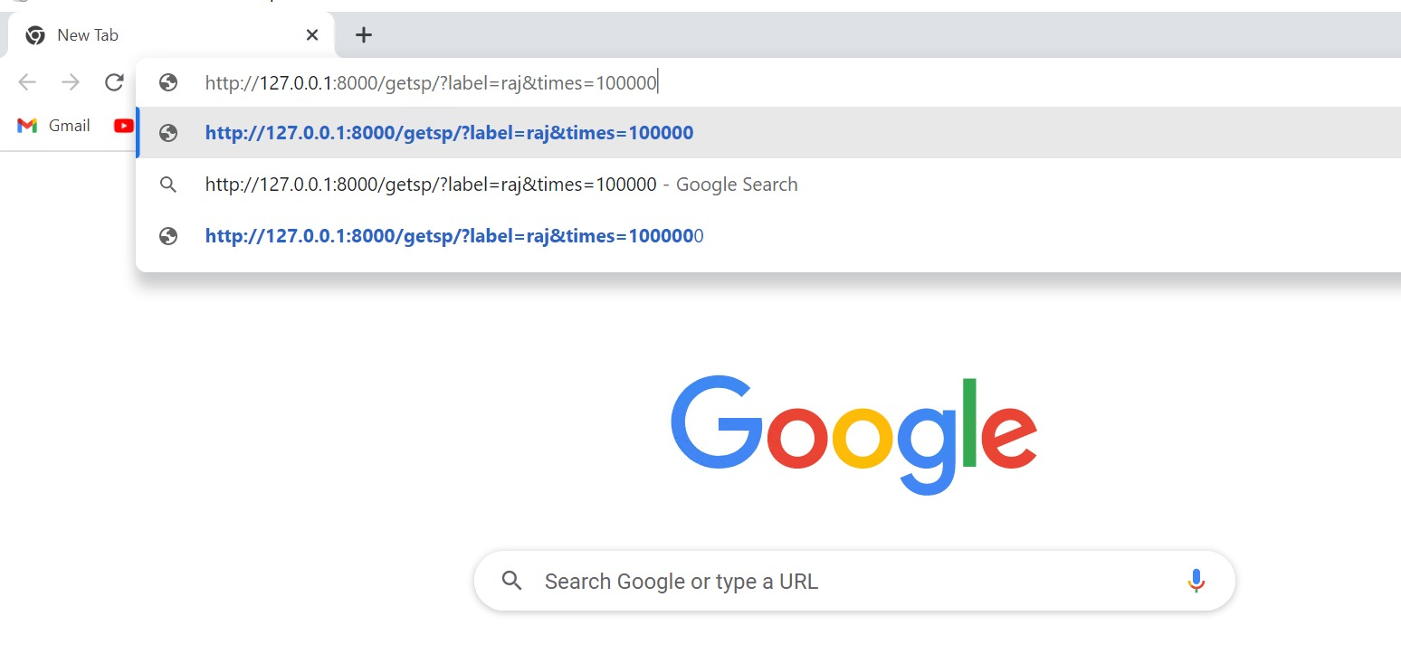
FAST API : ASYNCHRONOUS TESTING

Slide 14
Oracle Native JSON Functionality
Oracle database 19c allows JSON data to instantiate user-defined object type instances, and user defined object-type instances can be converted to JSON data.
Oracle Database supports JSON natively with relational database features, including transactions, indexing, declarative querying, and views. Unlike relational data, JSON data can be stored in the database, indexed, and queried without any need for a schema that defines the data.
The JSON data is schema less, even though a database schema is used to define the table and column in which it is stored. Nothing in that schema specifies the structure of the JSON data itself.

Slide 15
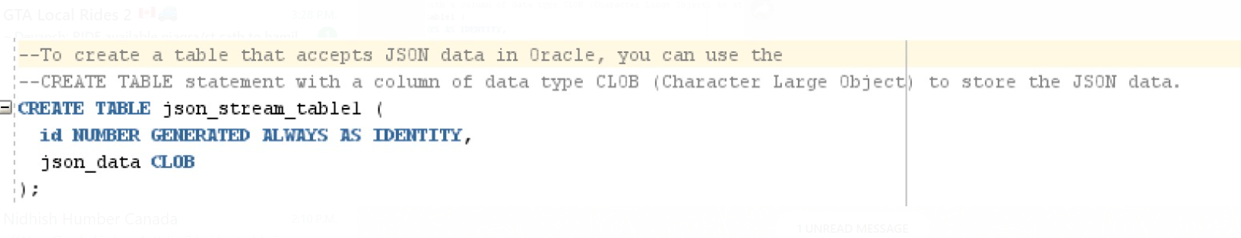
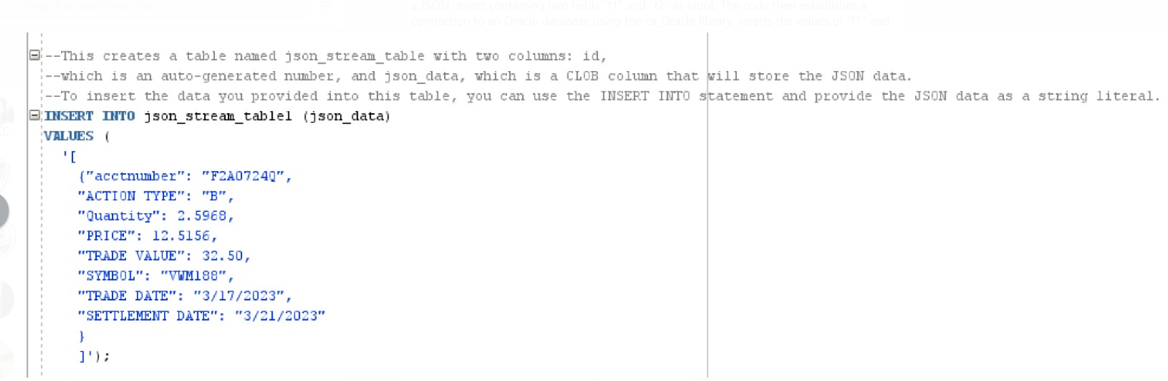
JSON Data insertion functionality in oracle
Creating table
Inserting into the table

Slide 16
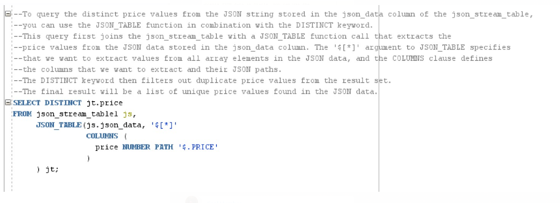
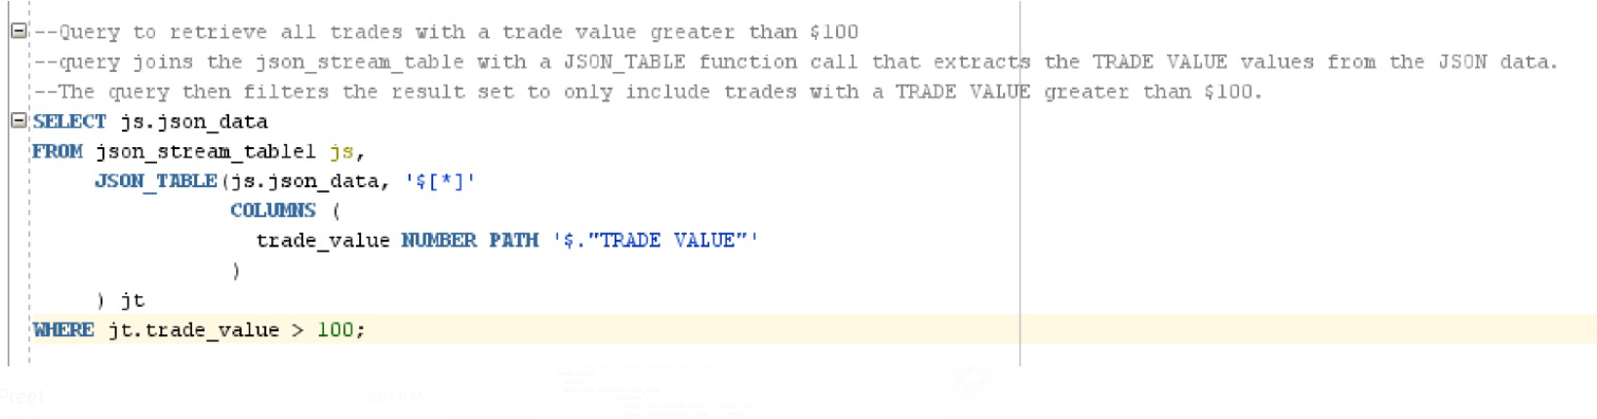
JSON Data insertion functionality in oracle
Selecting from the table

Slide 17
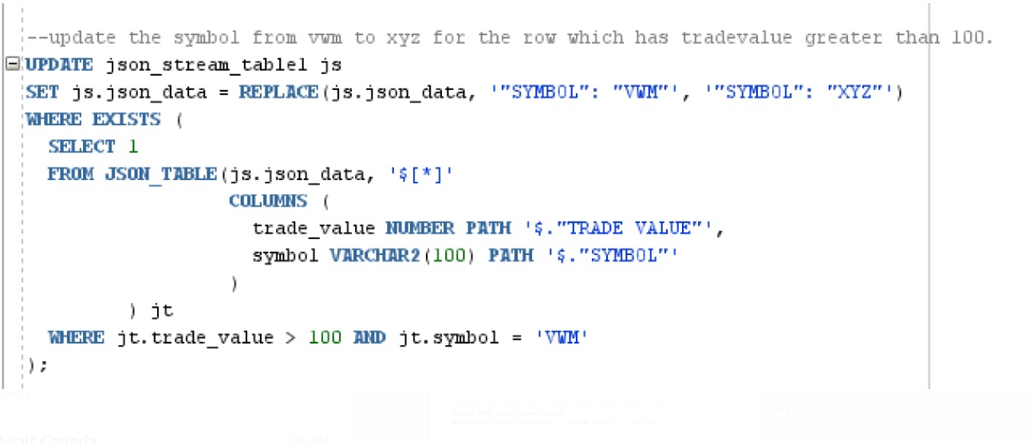
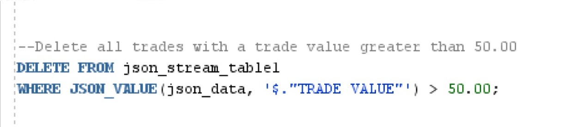
JSON Data insertion functionality in oracle
Updating the table
Deleting the table based on the condition

Slide 18
PYTHON JSON FUNCTIONALITY
JSON can store Lists, bools, numbers, tuples and dictionaries. But to be saved into a file, all these structures must be reduced to strings. It is the string version that can be read or written to a file. Python has a JSON module that will help converting the data structures to JSON strings. Use the import function to import the JSON module.
The JSON module is mainly used to convert the python dictionary above into a JSON string that can be written into a file.
json_string = json.dumps(datastore)
The JSON module can also take a JSON string and convert it back to a dictionary structure:
datastore = json.loads(json_string)

Slide 19
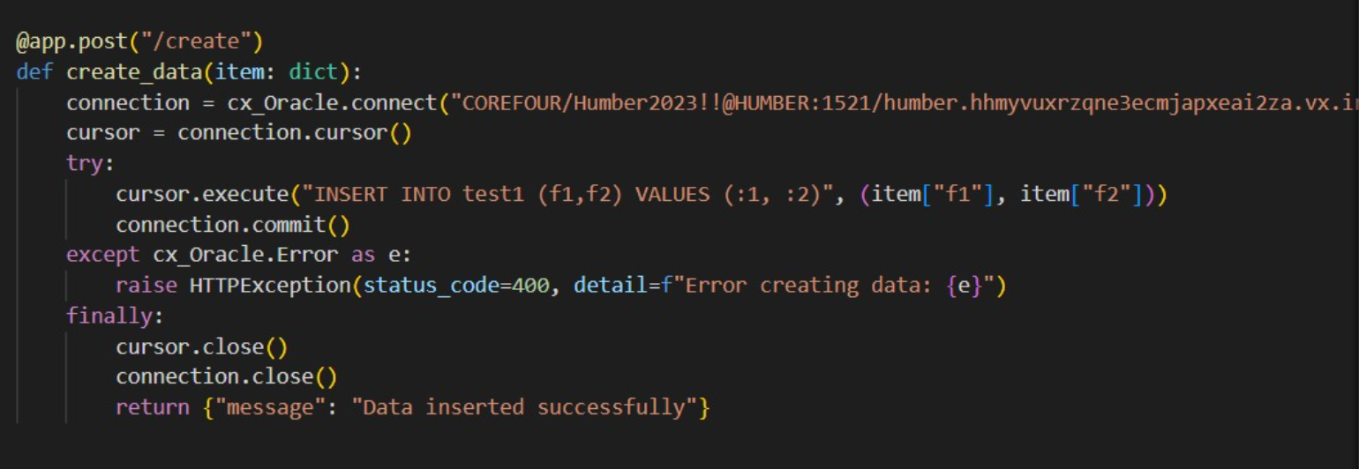
Json data insertion using fast api
The code defines a HTTP POST endpoint ("/create") in a FASTAPI application that receives a JSON object containing two fields "f1" and "f2" as input. The code then establishes a connection to an Oracle database using the cx_Oracle library, inserts the values of "f1" and "f2" into a table named "test1" in the database, and commits the transaction. If any error occurs during the database operation, a HTTP Exception with a status code of 400 and an error message is raised. Finally, the database connection is closed and a success message is returned

Slide 20
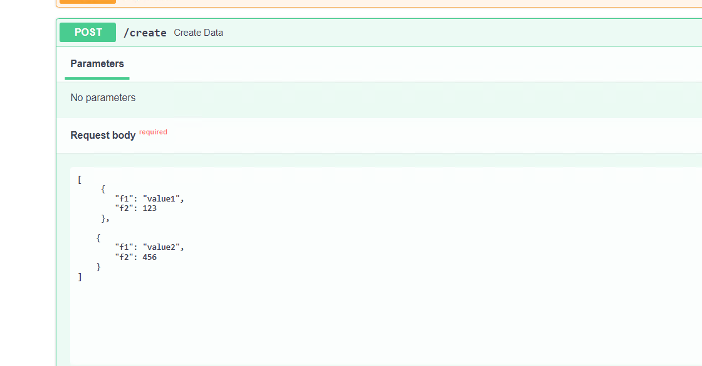
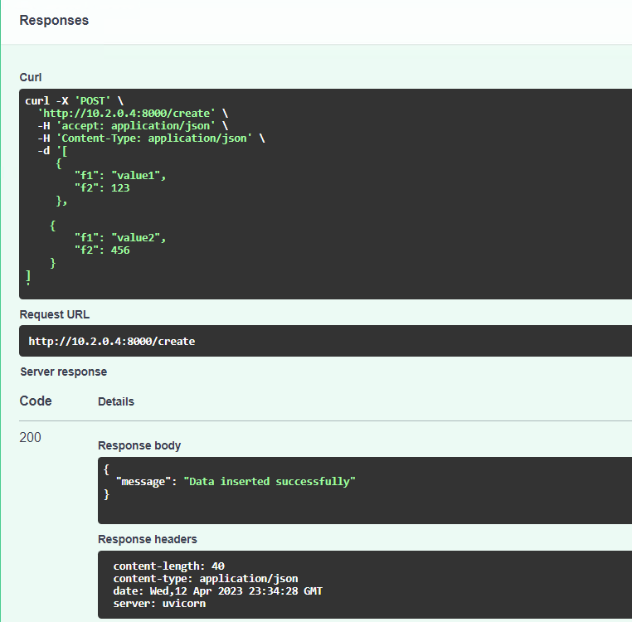
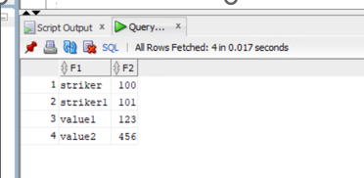
OUTPUT of Json data insertion using fast api
When checked in the database the data is inserted successfully.

Slide 21
PYTEST: TESTING ENVIRONMENT
Pytest is a Python-based testing framework, which is used to write and execute test codes. In the present days of REST services, Pytest is mainly used for API testing even though we can use Pytest to write simple to complex tests, i.e., we can write codes to test API, database, UI, etc.
Advantages of Pytest
The advantages of Pytest are as follows −
Pytest can run multiple tests in parallel, which reduces the execution time of the test suite.
Pytest has its own way to detect the test file and test functions automatically, if not mentioned explicitly.
Pytest allows us to skip a subset of the tests during execution.
Pytest allows us to run a subset of the entire test suite.
Pytest is free and open source.
Because of its simple syntax, Pytest is very easy to start with.

Slide 22
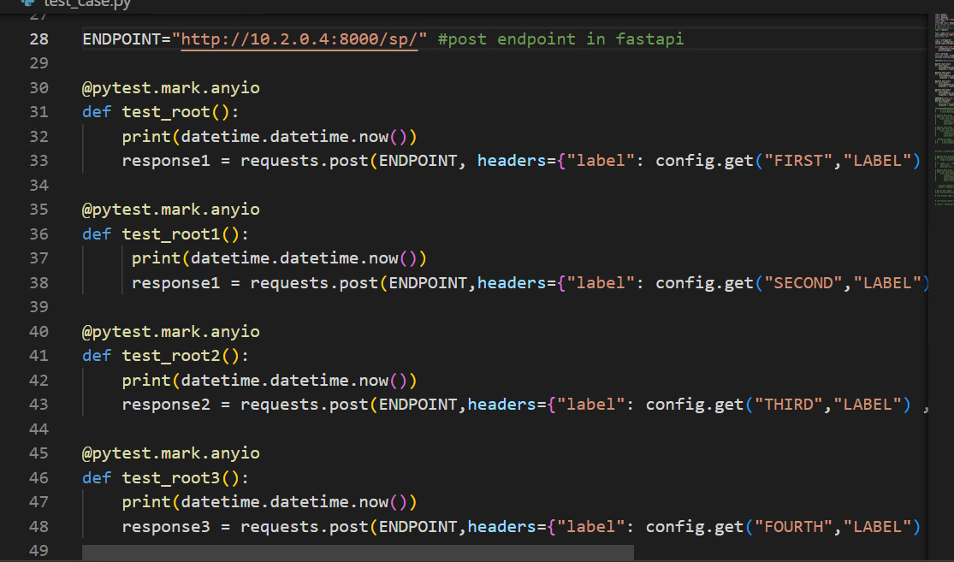
Pytest: testing environment
Creating a testing environment for endpoints using Pytest
Created four various function with a name starts with test to call the POST endpoint through URL (ENDPOINT variable has the value of URL) and We are using same URL on which our FASTAPI application is running.
To Run Pytest, Simply use below command:
Pytest

Slide 23
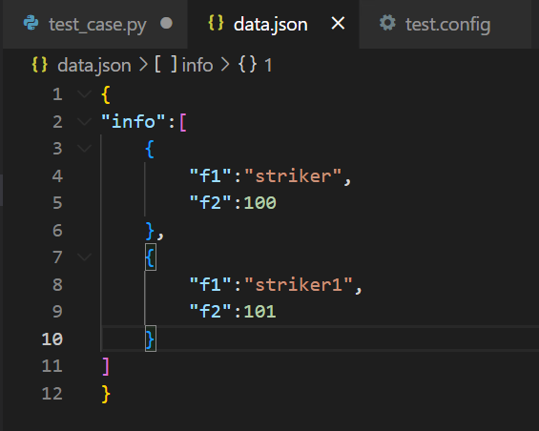
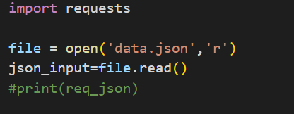
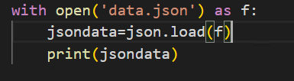
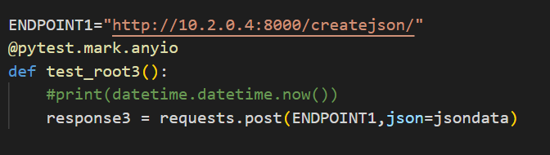
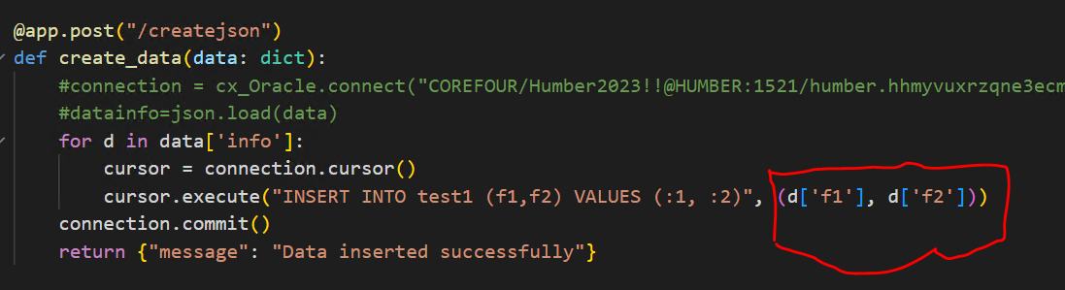
Pytest :testing environment
JSON data insertion through PYTEST
Pytest code for reading external JSON files and then loading that file into the JSON data variable.
Sending request on post endpoint with a name of creation to insert the data that we have read from external files
We have created an endpoint that accepts a dictionary, and we are passing /reading json data from external JSON file through Pytest code
We are iterating inside the list that we have passed inside JSON data
Inside the list it will go to first element and will take the values of F1 and F2 keys and then pointer will move to next element of info list

Slide 24
Research on api security measures

Slide 25
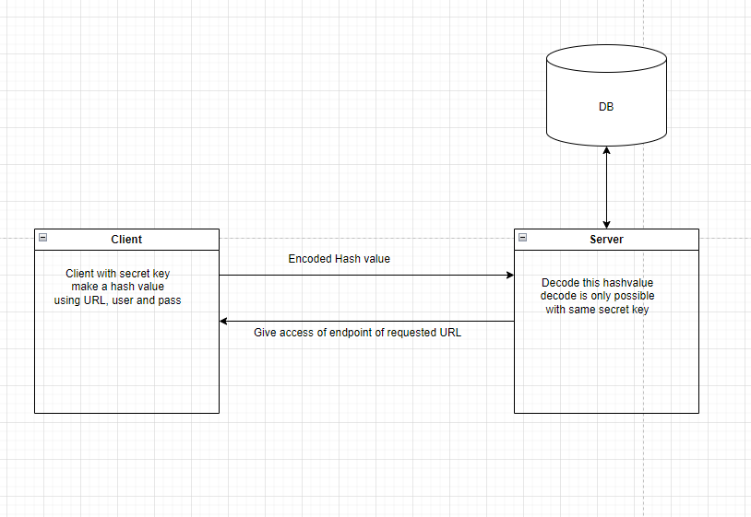
Research on security measure
JWT is a compact and self-contained way for securely transmitting information between parties as a JSON object. In the context of FastAPI, JWT is commonly used for authentication and authorization.

Slide 26
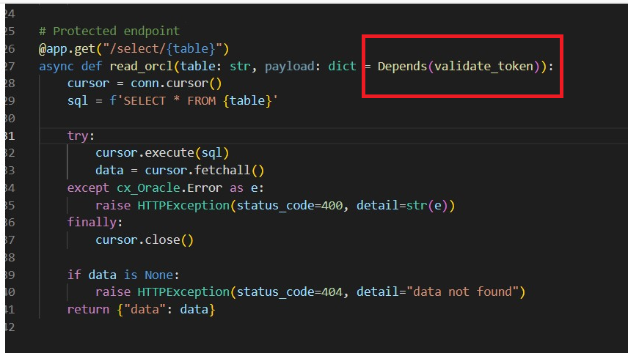
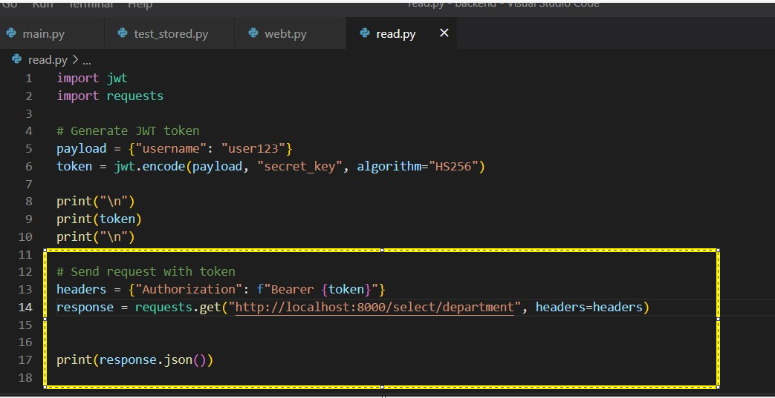
Research on security measure
The JWT token is generated by encoding a payload (which contains information such as username, user ID, etc.) using a secret key and an algorithm. The encoded JWT token is then passed in the header of an HTTP request to access a protected endpoint.
Here I have implemented basic JWT in my code on the local machine in sample database:

Slide 27
conclusion
Project Module | Sponsor Feedback | Team Feedback
FAST API | Successful Implementation all the way to production deployment | Using Fast API as the foundation for the API web framework is a wise choice. This will allow Sun Crest to handle a large volume of requests and provide real-time responses.
GET/ POST/ JSON | Successful Implementation of every method type required by Suncrest including processing of JSON streams | We have created GET/POST/ endpoint to read and insert structured and JSON data to the database.
PYTEST | Successful Implementation of comprehensive testing framework | We have tested the various endpoints by calling Pytest functions parallelly from different testing Environment.
Oracle Native JSON | Sufficient testing to determine that Oracle’s implementation is still immature – Oracle new 23c should be researched. | Using Oracle 19c, we implemented all the required operations to create test queries for parsing JSON stream through it.
API Security | Preliminary research and testing – work in progress.

Slide 28
THANK YOU
Team Core Four

Slide 29
references
https://www.oracle.com/database/
https://fastapi.tiangolo.com/
https://fastapi.tiangolo.com/tutorial/sql-databases/#connect-to-the-database
https://fastapi.tiangolo.com/tutorial/sql-databases-async/#connect-to-the-database
https://en.wikipedia.org/wiki/Create,_read,_update_and_delete
https://docs.oracle.com/en/database/oracle/oracle-database/21/lnpls/index.html
https://docs.python.org/3/library/asyncio.html
https://fastapi.tiangolo.com/tutorial/sql-databases/#crud
https://fastapi.tiangolo.com/tutorial/sql-databases/working-with-sqlalchemy-models/#crud-create-read-update-delete
https://fastapi.tiangolo.com/tutorial/sql-databases/async-sql-databases/#crud-create-read-update-delete
https://www.json.org/
https://fastapi.tiangolo.com/tutorial/request-models-json-schema/#request-body-models
https://www.oracle.com/tools/sql-developer/
https://docs.oracle.com/en/database/oracle/sql-developer/index.html
https://fastapi.tiangolo.com/tutorial/testing/
https://fastapi.tiangolo.com/tutorial/testing-dependencies/
https://fastapi.tiangolo.com/tutorial/testing-orm-queries/
https://fastapi.tiangolo.com/deployment/

